Slide 1
State/Local Income Tax Refunds and Other Recoveries
Pub 4012 – Tab D
Pub 4491 – Lesson 9
Notes:
Slide Deck Release 2 changes
#15, 16 added hyphen to non-refundable
Tax refunds and recoveries occur regularly
All counselors should have good working knowledge of the no-benefit rule
Practice using either the TaxSlayer or Bogart calculators is encouraged
The comprehensive topic at the end is for Unused Non-refundable Credits (another way that there was no benefit)

Slide 2
State Tax Refund
Point of awareness
Form 1099-G – State or local income tax refund
Notes:
Encourage counselors to ask probing questions
It is not “prying,” it is essential to an accurate return

Slide 3
Recoveries in General
In a prior year, you
Paid an expense, and
Deducted the expense, and
Your taxes were reduced
In current year
You received a refund or reimbursement of the expense
The refund or reimbursement received in 2018 is taxable … to the extent that taxes in the prior year were reduced
Called the Tax Benefit Rule
Notes:
This is called the tax benefit rule

Slide 4
Recoveries
Most common occurrence is state or local tax refund (has its own line on the return)
Other recoveries
Shown on Schedule C, E, or F if related
Other taxable recoveries would be shown as Other Income on the return
Notes:
This lesson is for state income tax recoveries only

Slide 5
State Tax Refund: No Tax Benefit in 2017
During the interview determine if:
The standard deduction was used in 2017
Sales tax was deducted in 2017
Taxable income plus refund is less than zero
Yes to any – refund nontaxable
Notes:
Emphasize
If did not itemize, then no reduction in tax liability for 2017 from state income tax paid
If itemized and took sales tax deduction instead on income tax deduction, then no benefit on 2017 return from income tax paid
If taxable income after all deductions and exemptions was negative and that negative amount was more than the refund, then no benefit. That is, would not have paid any more federal tax if had not claimed that refund amount anyway.

Slide 6
State Tax Refund: No Tax Benefit in 2017
No tax benefit – take no action in TaxSlayer
Do not enter the refund
Note “not taxable” and reason in Intake Booklet

Slide 7
Needed Information If Some Benefit
If some benefit must have 2017 return to determine taxable portion
Form 1099-G Box 3 must be 2017
Exception to 2017 rule:
If taxpayer agrees 100% taxable
If taxpayer claimed standard deduction for all years (0% taxable)
If taxpayer claimed sales tax deduction for all years (0% taxable)
Notes:
Emphasize the calculation is complex and out of scope when:
If taxpayer received a refund from a year prior, for example to 2014
Example of why:
Filed 2013 (standard deduction) and paid balance due in 2014
Filed 2014, itemized and claimed state income tax deduction (including bal due on 2013)
Filed amended 2013 and got state income tax refunded, received in 2015
Would need to test 2014 return for the taxable amount of the refund based on 2013 return – too complex

Slide 8
Calculation Worksheets
Pub 4012 Tab D
Options to determine taxable amount of refund
TaxSlayer State Refund Worksheet
Pub 4012, Tab D
Bogart Refund Calculator
COTAXAIDE.ORG/TOOLS

Slide 9
Income Tax Versus Sales Tax
Look at 2017 Schedule A Line 5
The taxable amount will never be more than the income tax deduction claimed minus the sales tax deduction that could have been claimed

Slide 10
How Calculate 2017 Sales Tax
Pub 4012 Tab F
Take AGI from 2017 Form 1040 Line 37
Add income not taxed (e.g. non-taxable SS, SSI, VA benefits)
Find worksheet in NTTC-modified Pub 4012 Tab F
Use Sales Tax Deduction Calculator at irs.gov to determine state and local sales tax for 2017 return
Input in worksheet
Notes:
Go to IRS.gov, search sales tax calculator, which will compute sales tax per the tables for a number of prior years

Slide 11
State Tax Refund Worksheets
Most common error:
Forgot to input sales tax that could have been deducted
Notes:
Emphasize
Can go to IRS.gov, search sales tax calculator, which will compute sales tax per the table for a number of prior years
Can use instructions for Schedule A and pick sales tax from the table

Slide 12
Example of Other Recovery
Taxpayer paid hospital bills in 2017 and deducted them on Schedule A
Insurance reimbursed those expenses in 2018
Taxable amount of reimbursement (amount which created a prior year tax benefit) is reported as other income

Slide 13
Quality Review
Confirm tax refund was only for 2017 or one of the exceptions applies
Review prior year’s return
Itemized
Income tax deducted
Negative taxable income
Any unused credits (see Comprehensive Topic later)
Notes:
All counselors should be aware to look for unused non-refundable credits if there is a refund or recovery
Can refer to more experienced counselor

Slide 14
Summary
Show taxpayer portion of refund that is taxable, if any

Slide 15
Comprehensive Topic
Unused Non-refundable Credits

Slide 16
Unused Tax Credits in 2017
Confirm if there were unused tax credits – look at 2017 tax return
Was tax after non-refundable credits zero?
If so, there are potential unused credits
Note: TaxSlayer limits a credit before putting on Form 1040 – will need to look at details of the credits for the full amount
Open the prior year return if prepared at your site
Will be easier to calculate taxable refund – see instructions in Bogart Refund Calculator
Notes:
Note: TaxSlayer limits credits on Line 55 to total tax due on Line 47 so a zero on Line 55 does not mean every possible non-refundable credit was used, only enough to offset tax due.

Slide 17
Unused Tax Credits in 2017
Taxable amount of recovery is limited to
Refund amount
- less-
Amount of additional income that creates tax equal to credits (this is the no-benefit portion)
Use the Bogart refund calculator
Notes:
Note: TaxSlayer limits credits on Line 55 to total tax due on Line 47 so a zero on Line 55 does not mean every possible non-refundable credit was used, only enough to offset tax due.

Slide 18
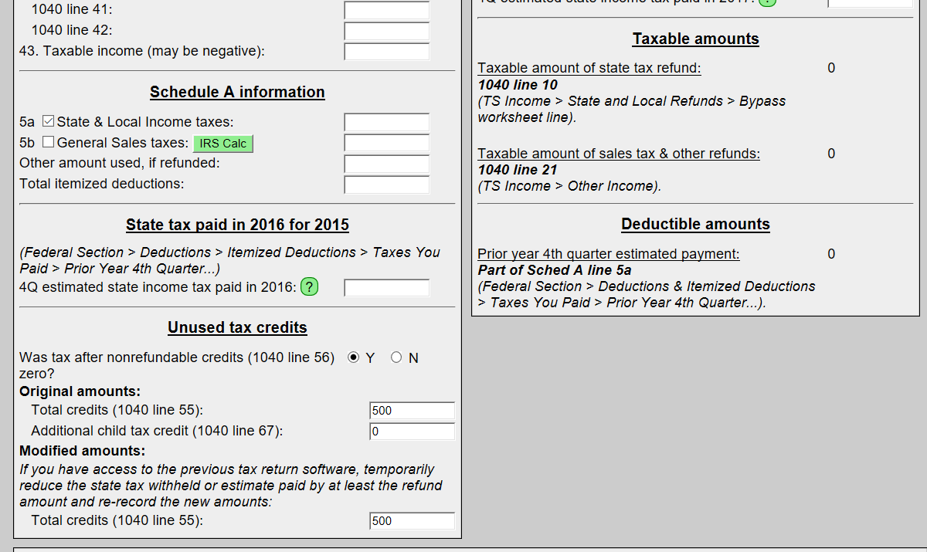
Bogart Refund Calculator
Results
will be here
Notes:
Also referred to as Bogart’s Taxable Refund and Recovery Calculator

Slide 19
State And Local Income Tax Refunds
Questions?
Comments…

